Slide 1
Image Captioning Using Vision Transformer

Slide 2
Contribution
Jagadeep Nannuri 700755937 (Model Evaluation, Code Implementation)
Varshitha Reddy 700757574 (Final Report , Code Review)
Vennela Pulavarti 700756480 (Analysis, Final Report,Code Reveiw)
Sudeep Kumar Kanthala 700755923 (Model Creation, Model Evaluation)

Slide 3
Motivation
To improve accessibility for visually impaired individuals.
Over 12 million visually impaired individuals above the age of 40 in the United States

Slide 4
Objectives
To generate descriptive sentences from images
To establish the relationship between sequential images
To enhance the mobility and independence of visually impaired individuals.
To enable more efficient image retrieval systems

Slide 5
Related Work
Salman Khan et al ‘ s survey reviews transformer-based models in computer vision
Vision Transformer (ViT)
Hybrid Vision Transformer (HVT)
Modified Transformer architecture
Swin Transformer
Generative Image to-text Transformer

Slide 6
Problem Statement
With over 12 million visually impaired individuals above the age of 40 in the United States alone,
This approach has potential applications in enabling more efficient image retrieval systems and improving accessibility for visually impaired individuals.

Slide 7
Proposed Solution
Training a transformer-based deep learning model
Dataset Used - Flickr8K dataset
The encoder part utilizes a pre-trained Vision Transformer to extract features from an image.
After extracting the features, they are fed to the transformer decoder network to generate captions.
Model’s performance - evaluated using BLEU

Slide 8
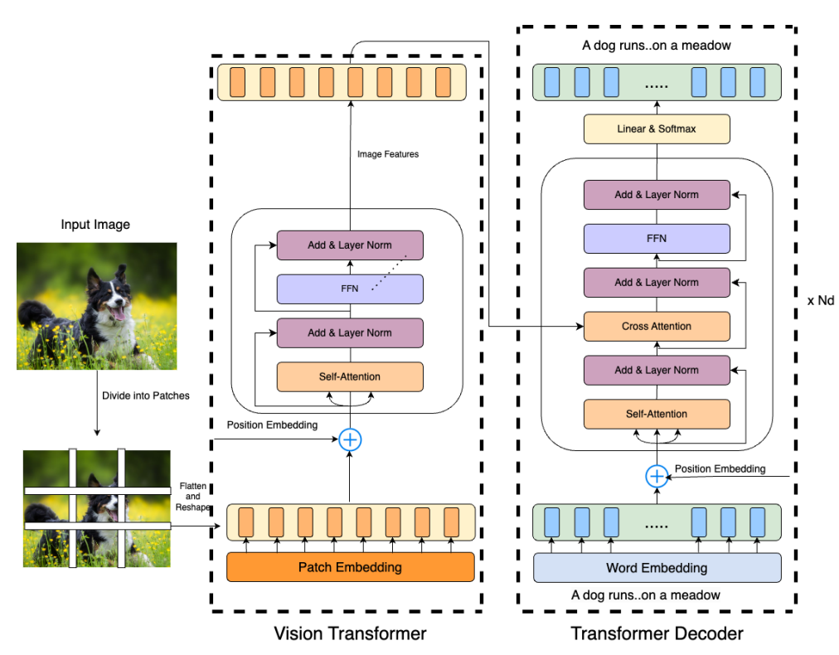
Architecture
Attention Mechanism in Transformer Networks
Multi-Headed Attention Mechanism
Encoder
Decoder

Slide 9
Training
Loss Function and Optimizer
Hyperparameter Selection
Evaluation - BLEU Scores

Slide 10
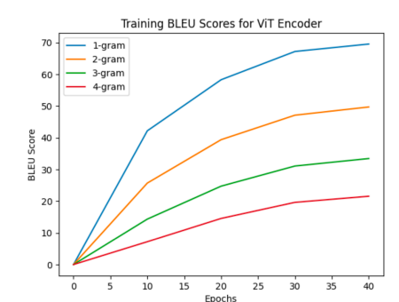
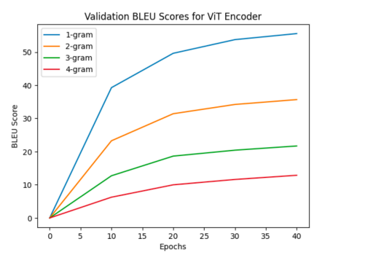
Result

Slide 11
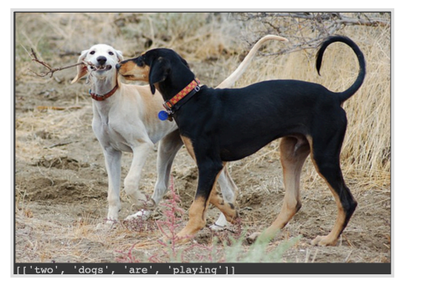
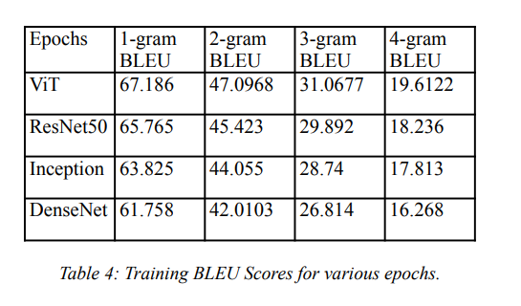
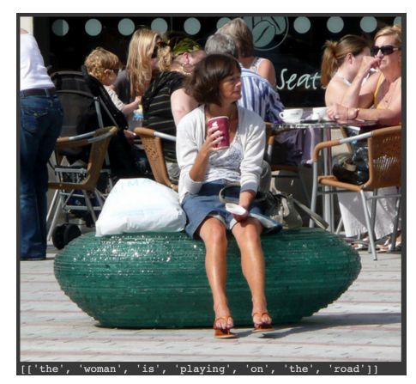
Result

Slide 12
References
Wang, Yiyu, Jungang Xu, and Yingfei Sun. ” End-toend transformer-based model for image captioning.” In Proceedings of the AAAI Conference on Artificial Intelligence, vol. 36, no. 3, pp. 2585-2594. 2022.
He, Sen, Wentong Liao, Hamed R. Tavakoli, Michael Yang, Bodo Rosenhahn, and Nicolas Pugeault. ”Image captioning through image transformer.” In Proceedings of the Asian conference on computer vision. 2020.
Farhadi, Ali, et al. "Every picture tells a story: Generating sentences from images." Computer Vision– ECCV 2010: 11th European Conference on Computer Vision, Heraklion, Crete, Greece, September 5-11, 2010, Proceedings, Part IV 11. Springer Berlin Heidelberg, 2010
Wang, Jianfeng, Zhengyuan Yang, Xiaowei Hu, Linjie Li, Kevin Lin, Zhe Gan, Zicheng Liu, Ce Liu, and Lijuan Wang. ”Git: A generative image-to-text transformer for vision and language.” arXiv preprint arXiv:2205.14100 (2022).

Slide 13

Presented By
Vennela Pulavarti – 700756480
Varshitha Reddy – 700757574
Jagadeep Nannuri 700755937
Sudeep Kumar Kanthala 700755923

